Slide 1

Class 23:
Blooming Sidechains!
Cryptocurrency Café
UVa cs4501 Spring 2015
David Evans

Slide 2
Plan
Bloom Filters
Design and Analysis
Use in Bitcoin
Merged Mining
Sidechains
Thursday, 6pm Commerce School 223
“Entrepreneurial and Career Ventures in the world of Digital Currency” Panel
Friday, 10:45am Rice 242
Suman Jana, “Rise of the Planet of the Apps: Security and Privacy in the Age of Bad Code”
Project Presentations will be April 20, 22 and 27.

Slide 3
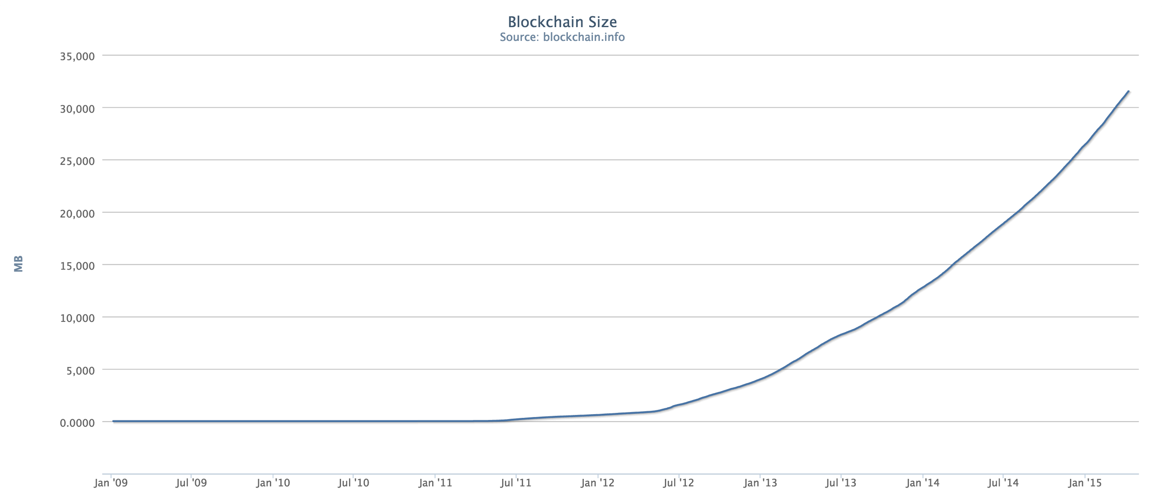
32 GB

Slide 4
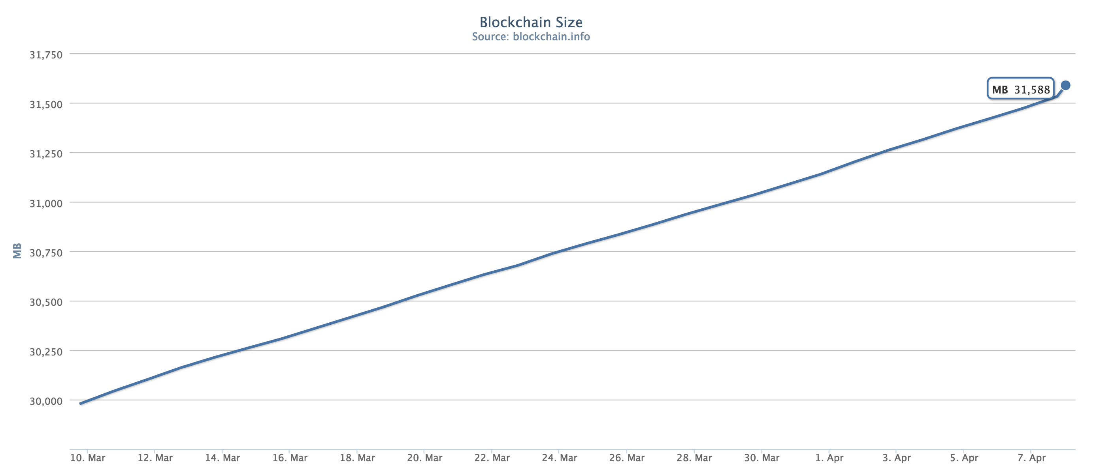
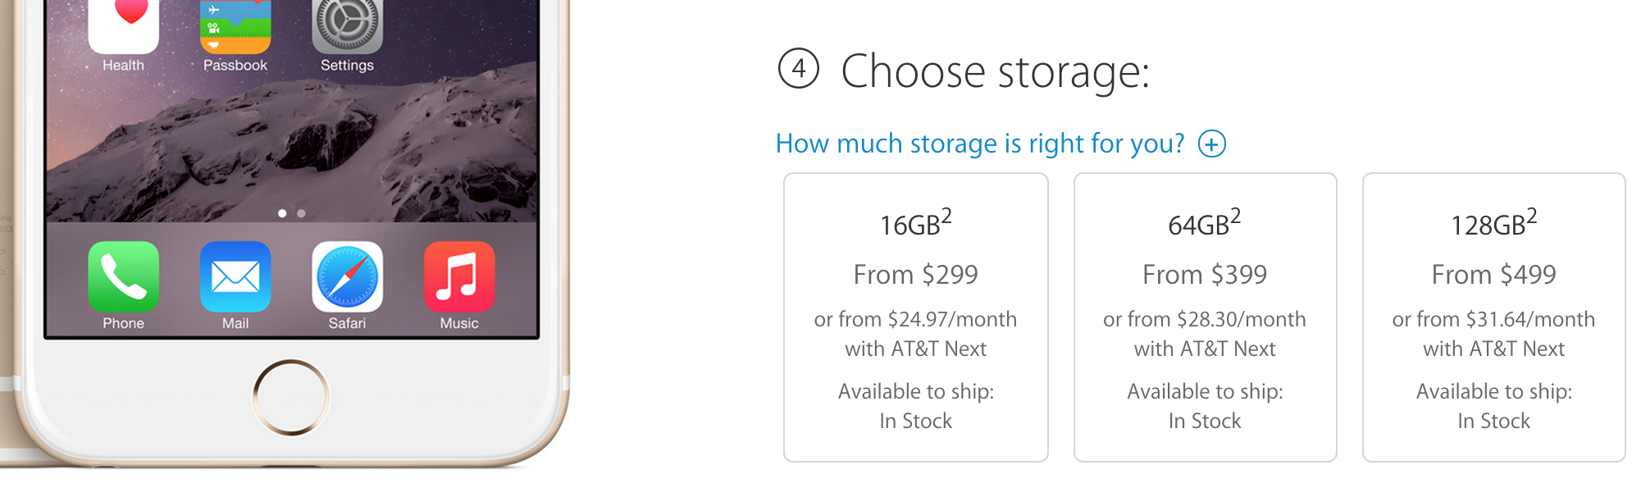

Slide 5
SPV Nodes
Simplified Payment Verification
SPV Wallet
filter
Full Node
blocks matching filter

Slide 6
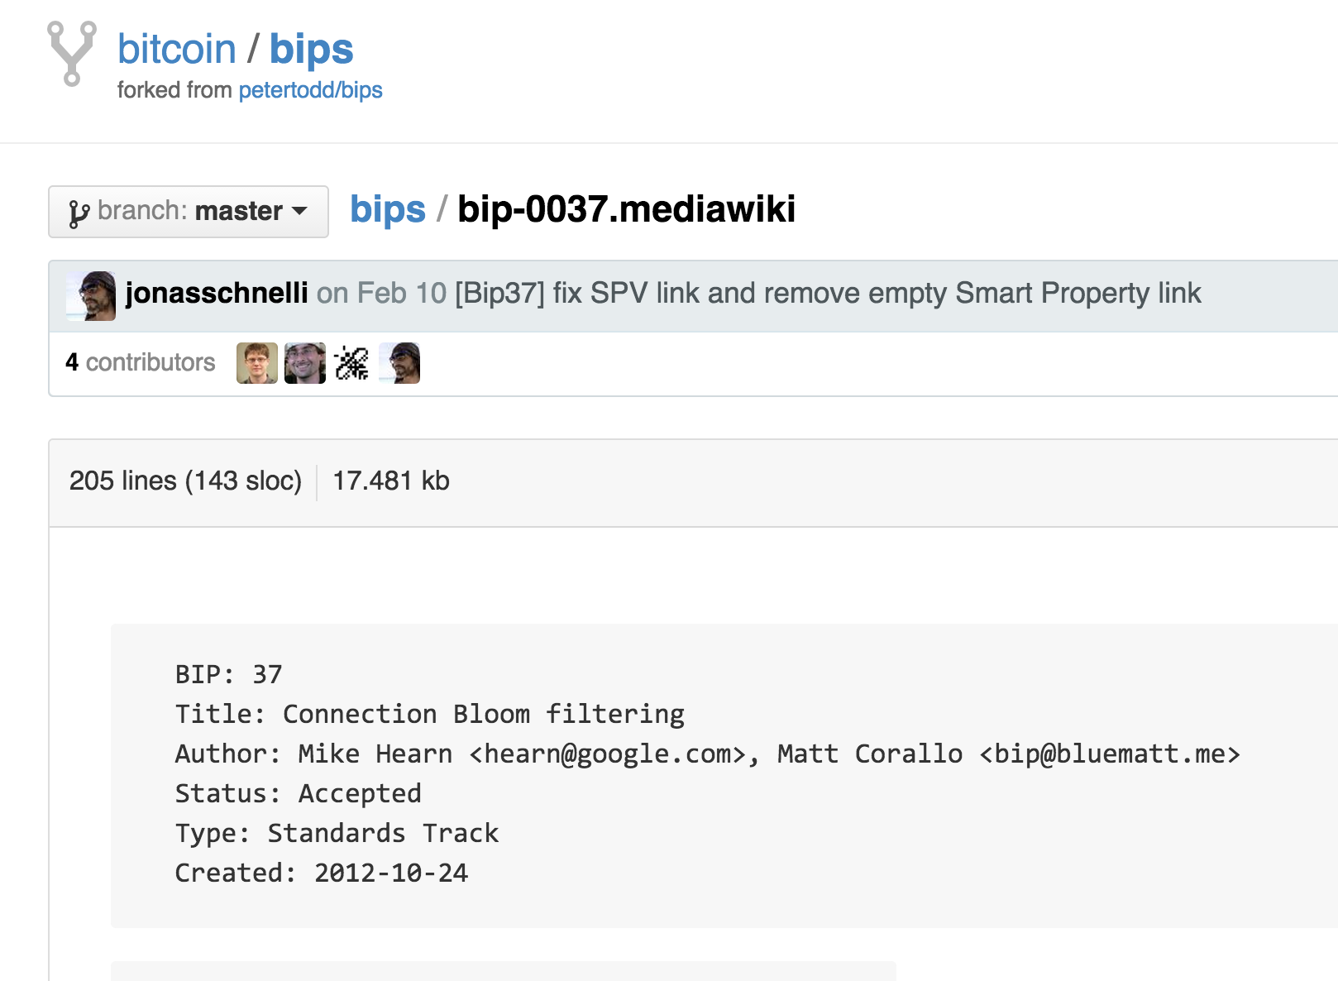

Slide 7
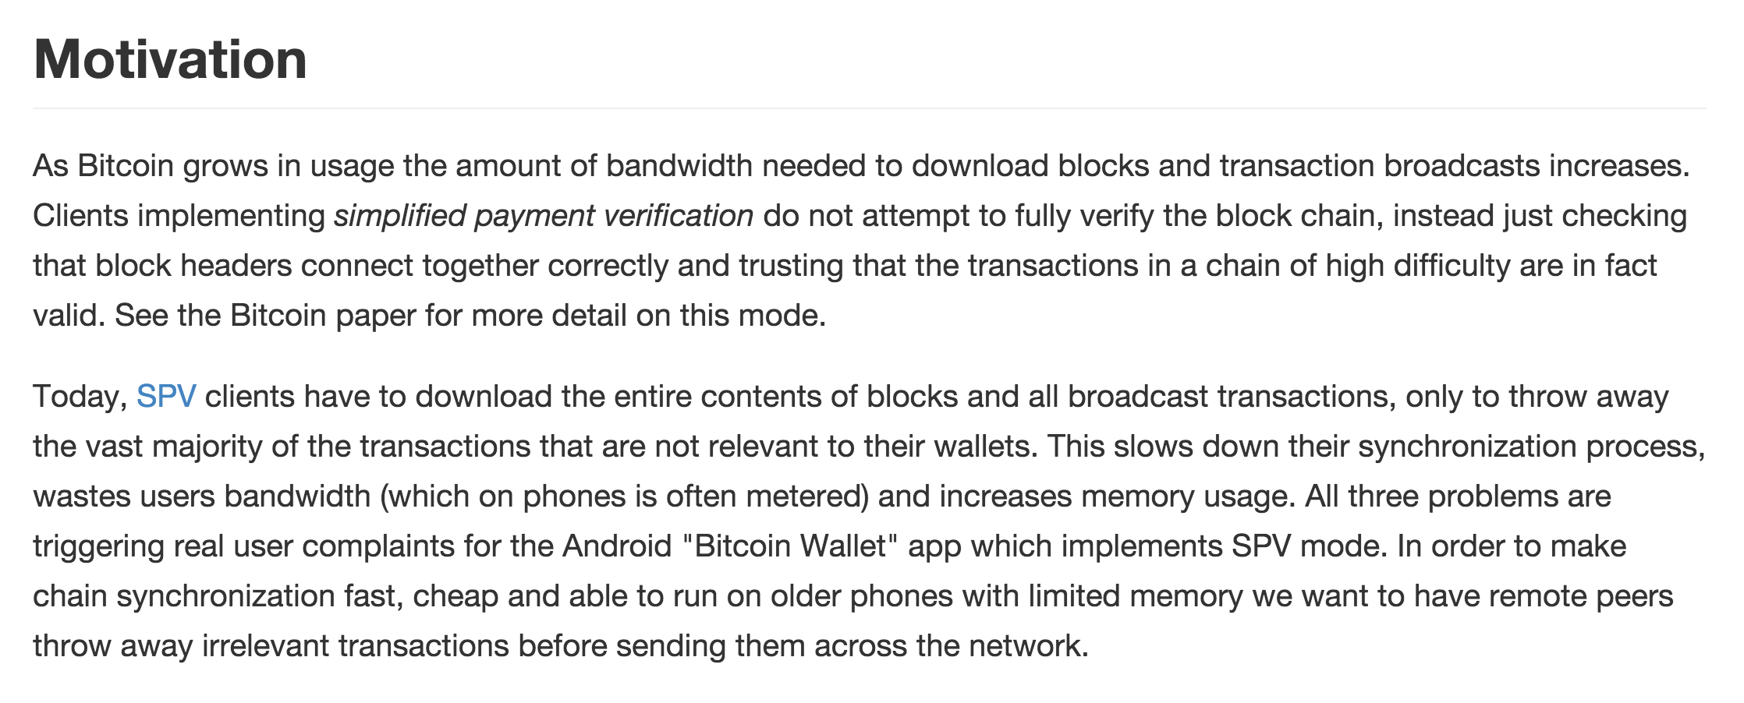

Slide 8

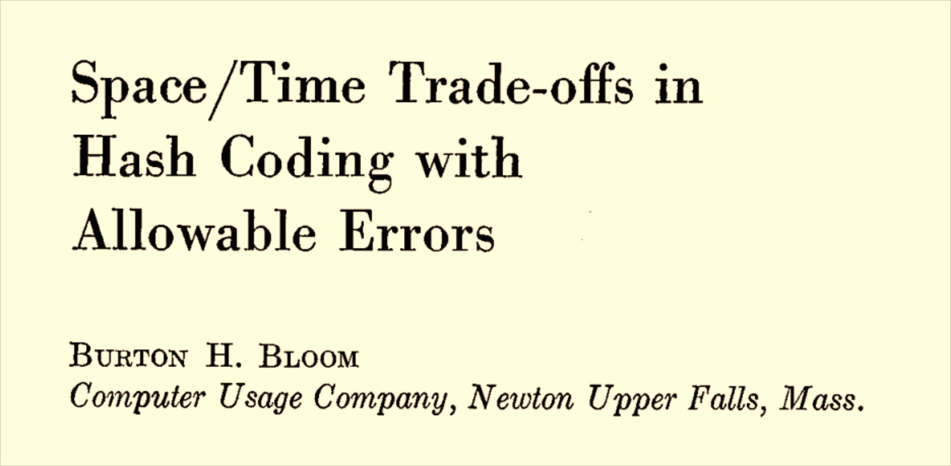
Bloom Filters

Slide 9
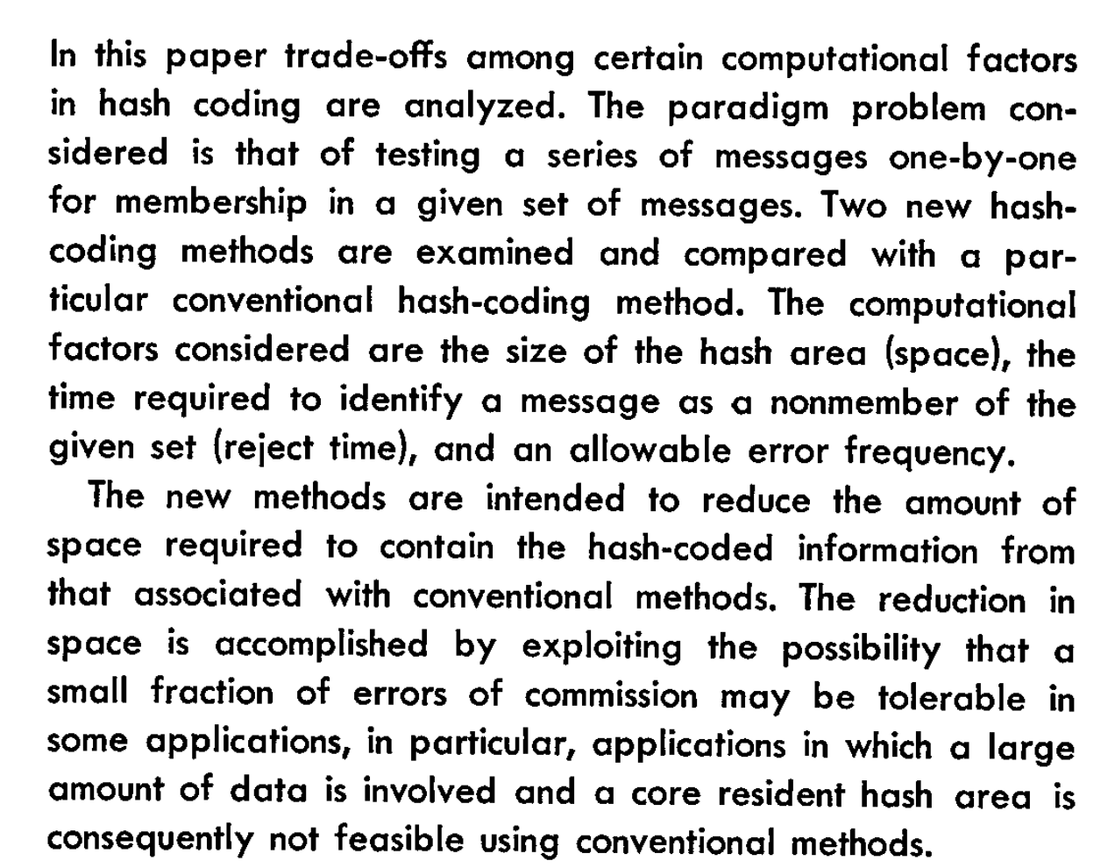

Slide 10
Conventional Hash Table
Store collection of N b-bit elements, using k > N cells.
H is pseudorandom function
H(x) ➔ [0, k)

Slide 11
Conventional Hash Table
Store collection of N b-bit elements, using k > N cells.
H is pseudorandom function
H(x) ➔ [0, k)

Slide 12
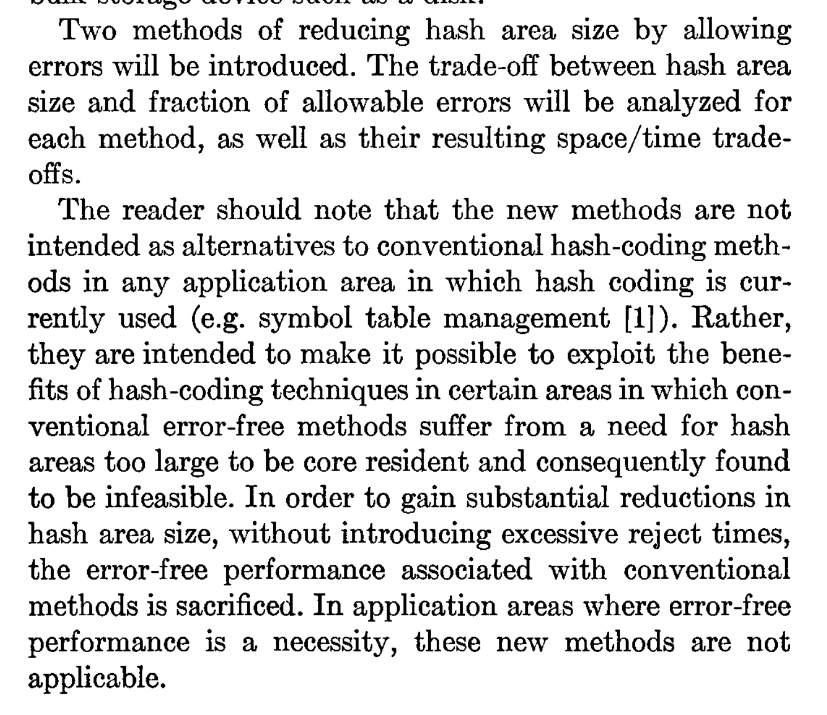

Slide 13
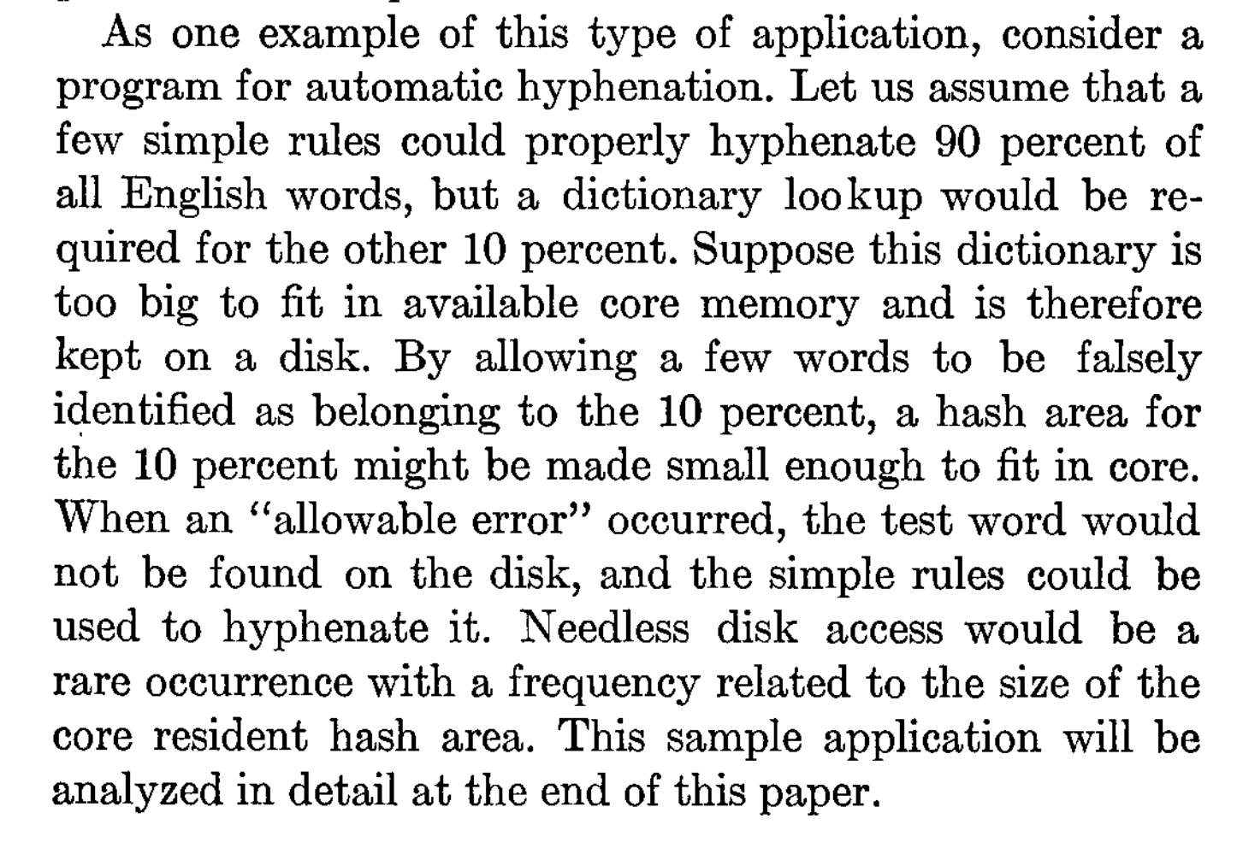
How does Bloom’s application compare to use by bitcoin SPV nodes?

Slide 14
Bloom Filter Design

Slide 17
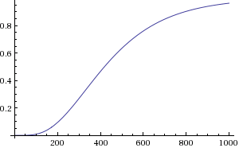
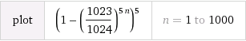
m: bits in array
k: number of hashes
n: number of elements
Probability of false match:
(1 – (1 – 1/m)^{kn})^{k}

Slide 18
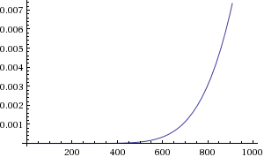
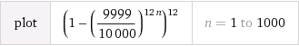
m: bits in array
k: number of hashes
n: number of elements
Probability of false match:
(1 – (1 – 1/m)^{kn})^{k}

Slide 19
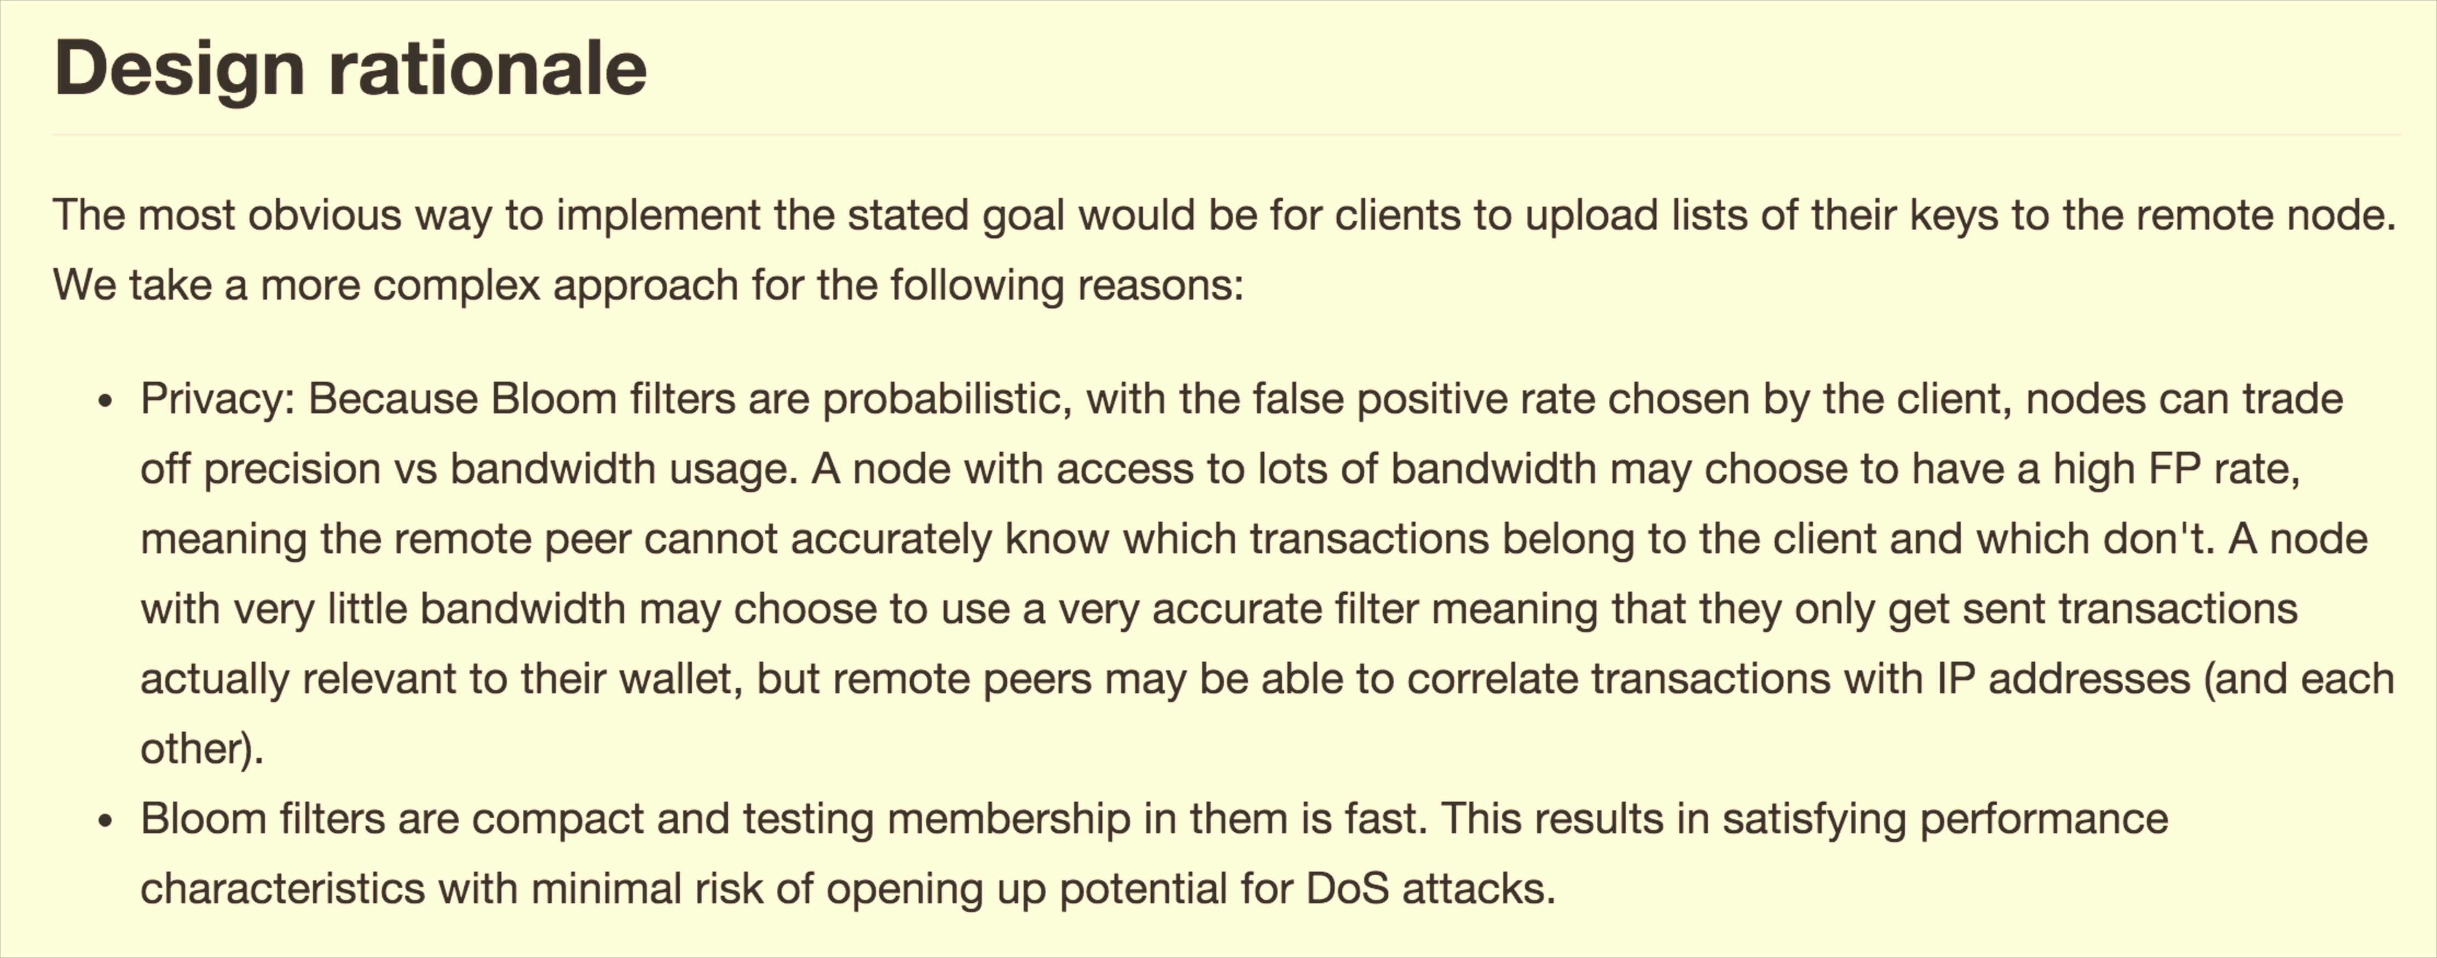
Do Bloom filters really provide privacy?

Slide 20
Merged Mining

Slide 21
Pointcoin 0
Pointcoin 1
…
Pointcoin 6764
Difficulty: 8,324,713
Hash rate: ~0 TH/s
Bitcoin 0
Bitcoin 1
…
Bitcoin 351247
Difficulty: 49,446,390,688
Hash rate: 310K TH/s
Should PointCoin Pizza be worried?

Slide 22
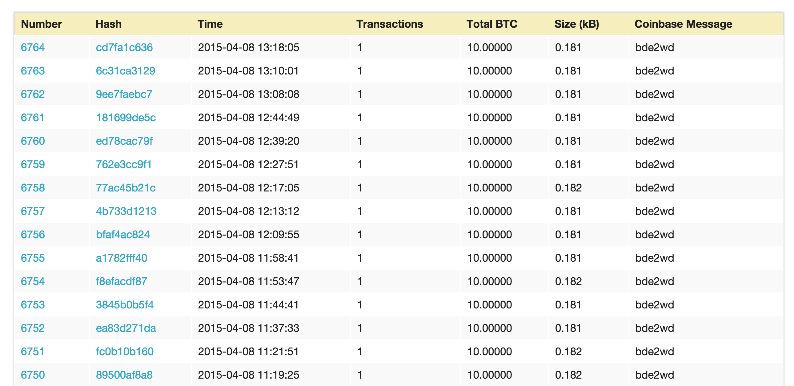
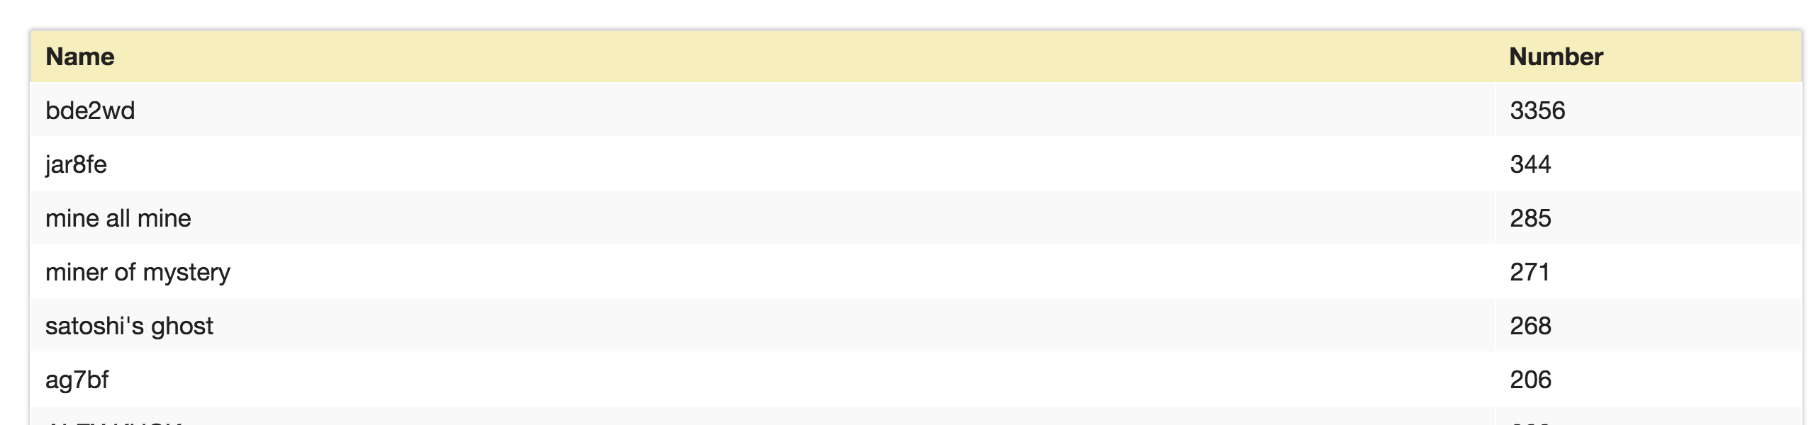
http://blockexplorer.bitcoin-class.org/

Slide 23
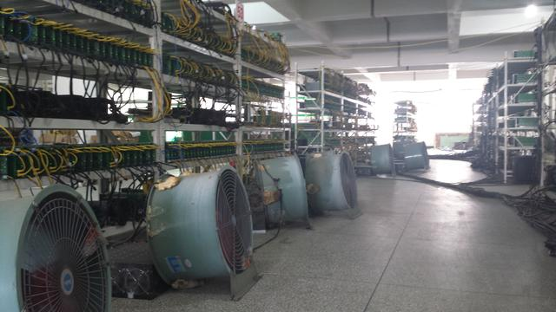
SHA-256 Proof-of-Work Cryptocurrency

Slide 24
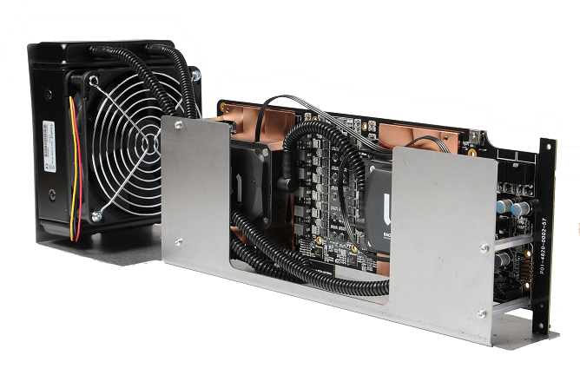
Merged Mining
Goal: Enable using same hashing power to mine both Bitcoin and Namecoin (with different difficulty)

Slide 26
https://explorer.namecoin.info/blocks/block_225529.txt

Slide 27
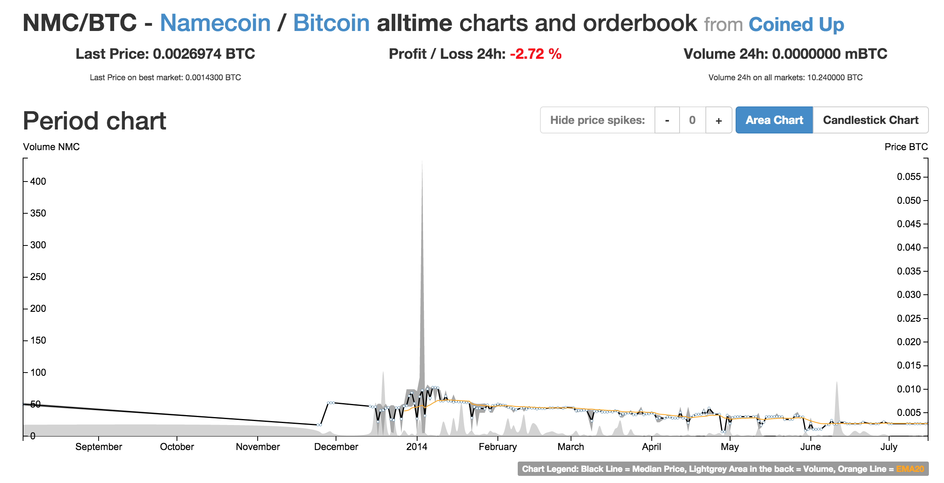

Slide 28
Pointcoin 0
Pointcoin 1
…
Pointcoin 6764
Difficulty: 8,324,713
Hash rate: ~0 TH/s
Namecoin 0
Namecoin 1
…
Namecoin 225529
Difficulty: 16,527,985,062
Hash rate: 110K TH/s
Bitcoin 0
Bitcoin 1
…
Bitcoin 351247
Difficulty: 49,446,390,688
Hash rate: 310K TH/s

Slide 29
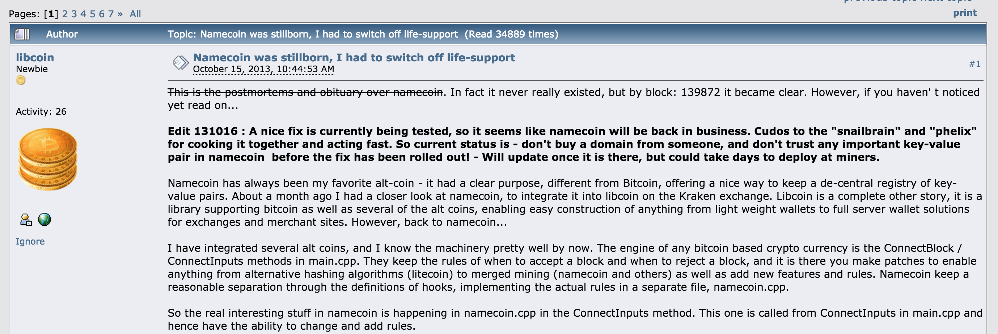
Namecoin Bug

Slide 30
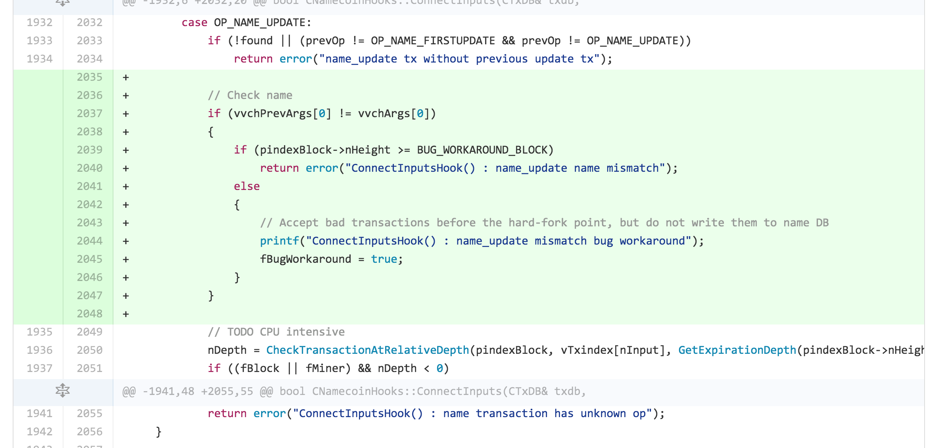
https://github.com/namecoin/namecoin/commit/d70d01ff77310d3755891cb43cb2700b553019f4

Slide 31
Charge
Projects should be making good progress now!
Thursday, 6pm Commerce School 223
“Entrepreneurial and Career Ventures in the world of Digital Currency” Panel
Friday, 10:45am Rice 242
Suman Jana, “Rise of the Planet of the Apps: Security and Privacy in the Age of Bad Code”
Project Presentations will be April 20, 22 and 27.

